Slide 1


HSN Code: 6310
Used or new rags, scrap twine, cordage, rope and cables and worn-out articles thereof, of textile materials, sorted
Aadish Jain(01)
Arun Gupta(17)
Deepak Sharma(19)
Shashank Maurya(47)

Slide 2
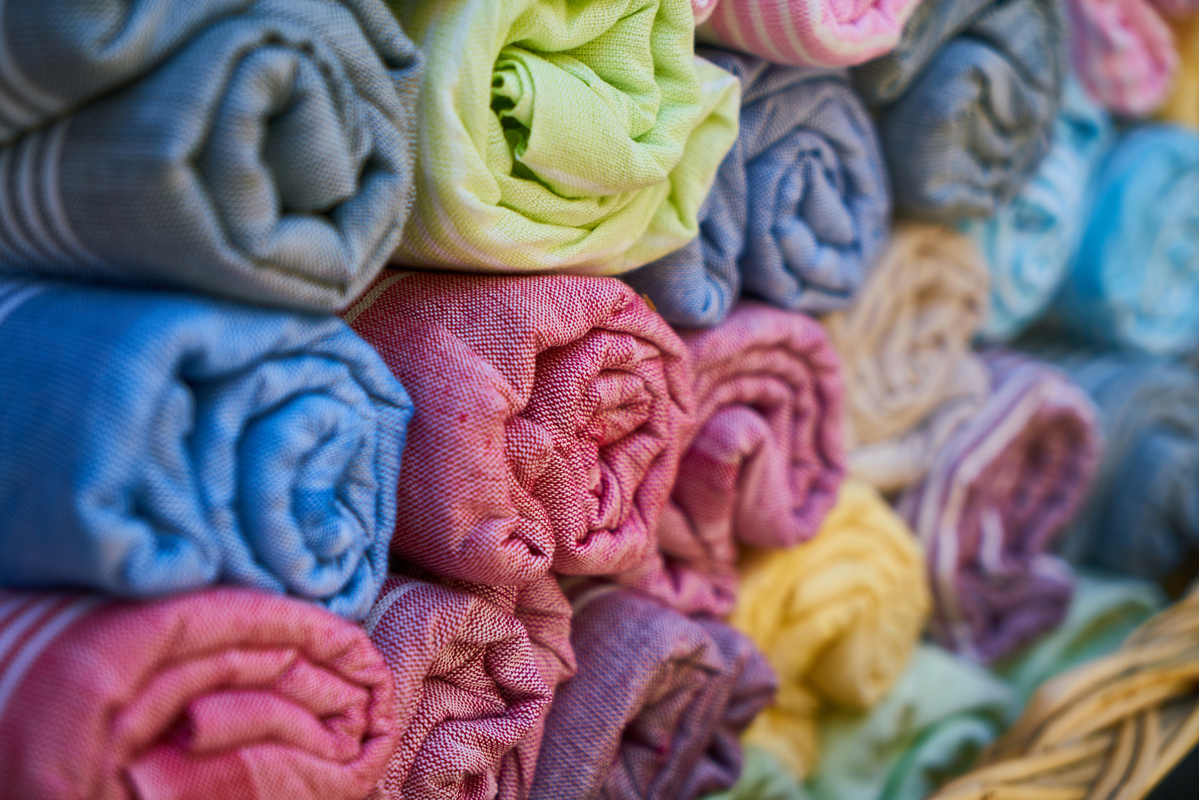
Indian Textile Industry: Key Data & Facts

Slide 3

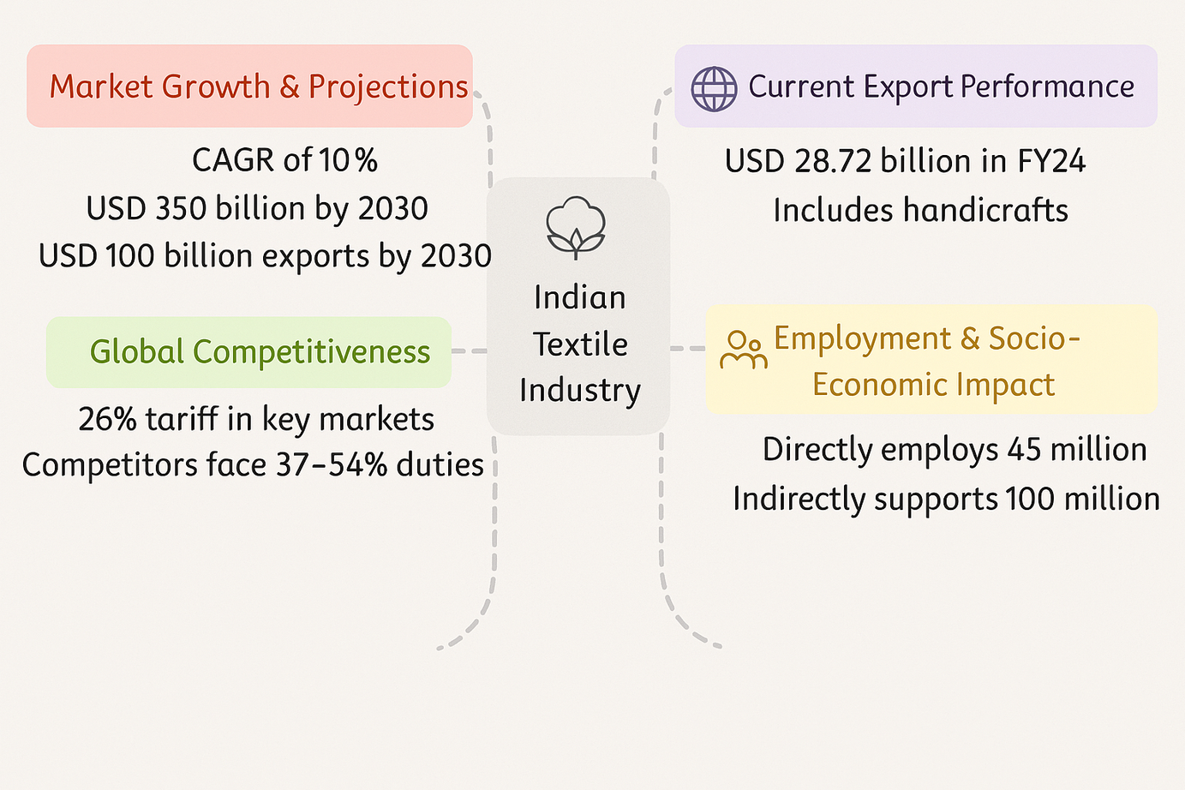
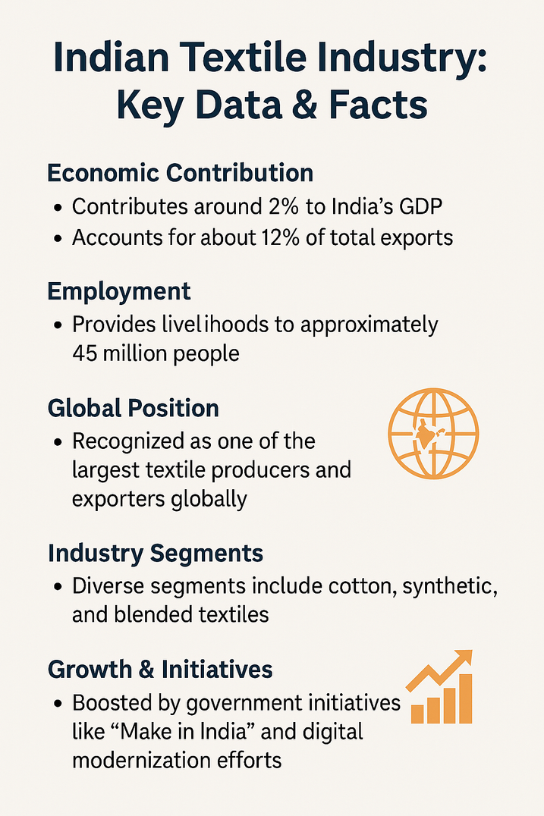

Slide 4

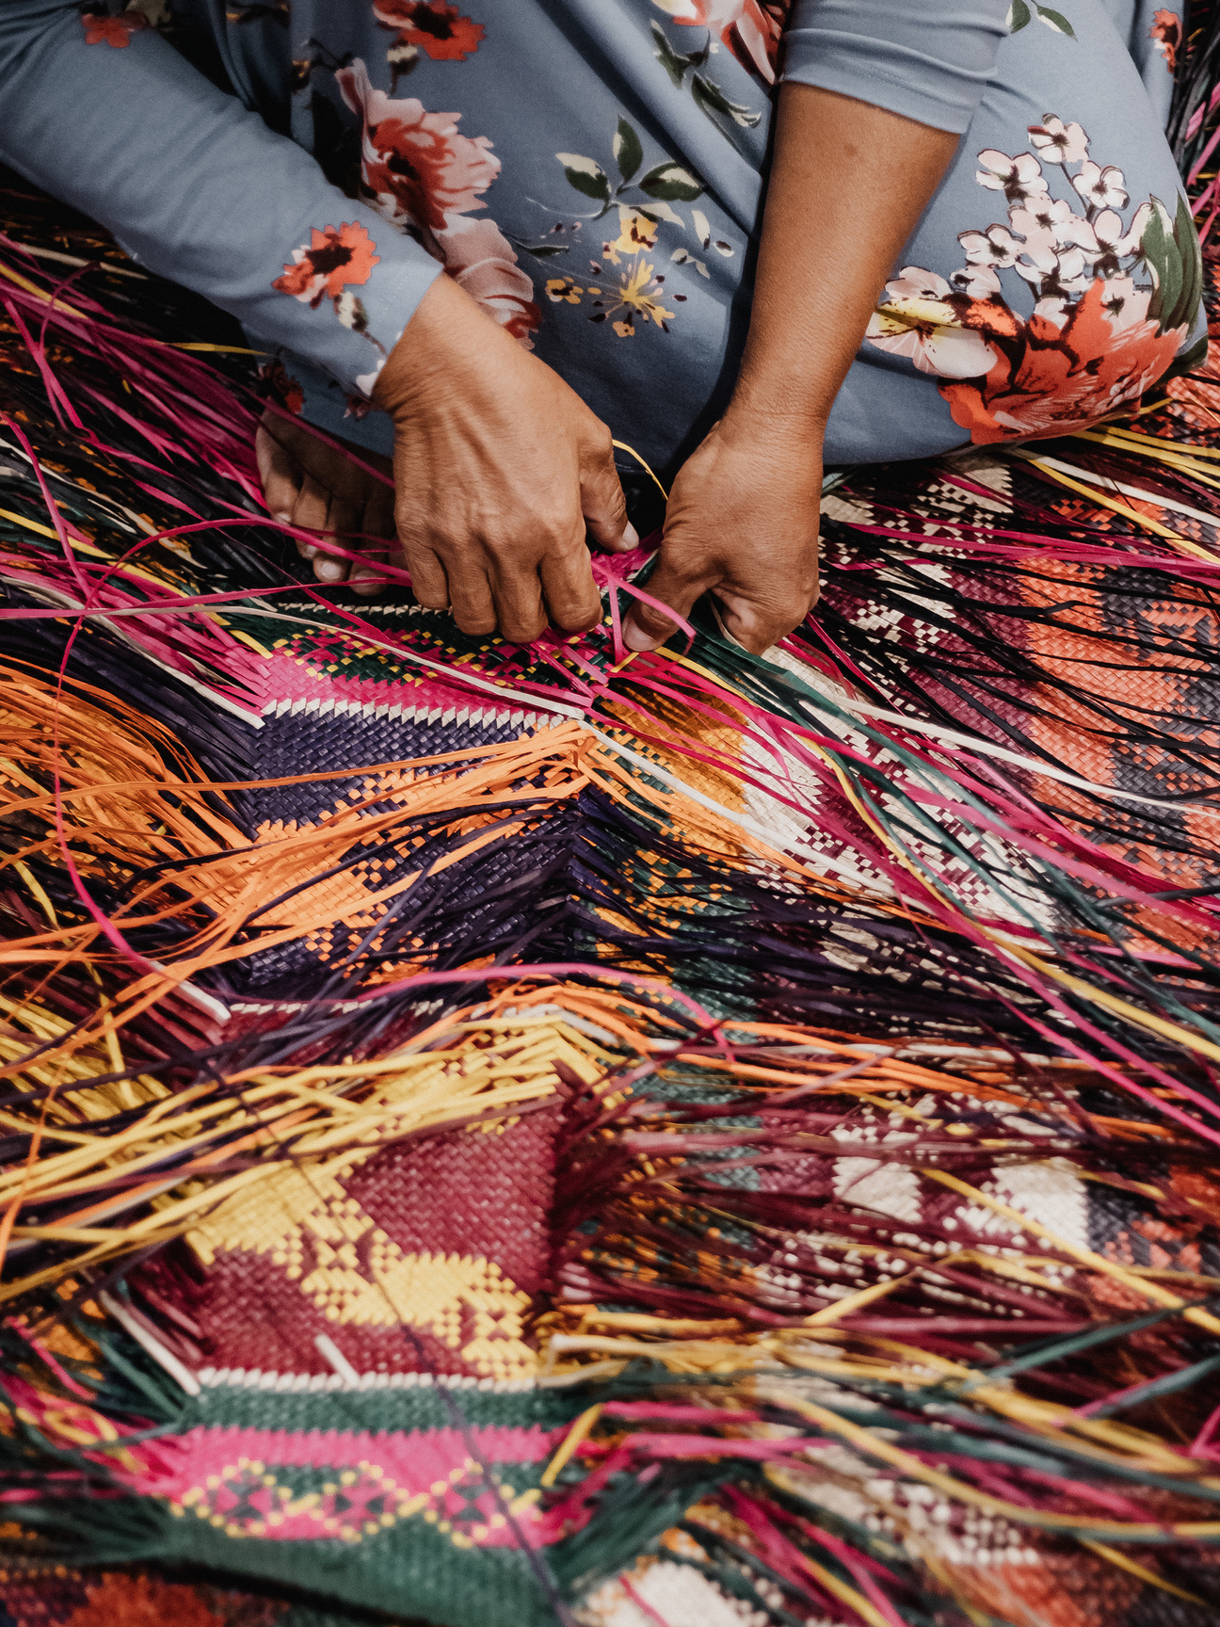
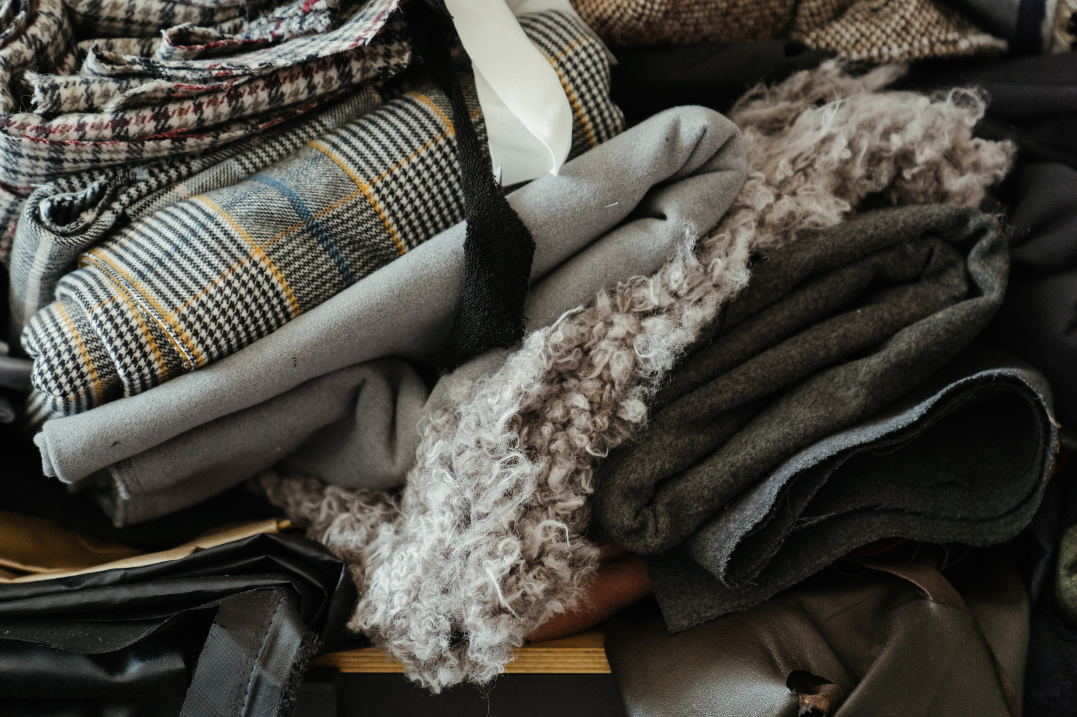
Worn Textile Industry
The global worn textile industry—which largely encompasses the second-hand apparel market—vary based on definitions and market segments. However, several industry reports provide useful benchmarks:
In recent years, the second-hand clothing segment was valued at around $28–30 billion.
Projections indicate that, driven by consumer demand for sustainable fashion and circular economy practices, this market could expand to roughly $64–77 billion by the mid-2020s.

Slide 5

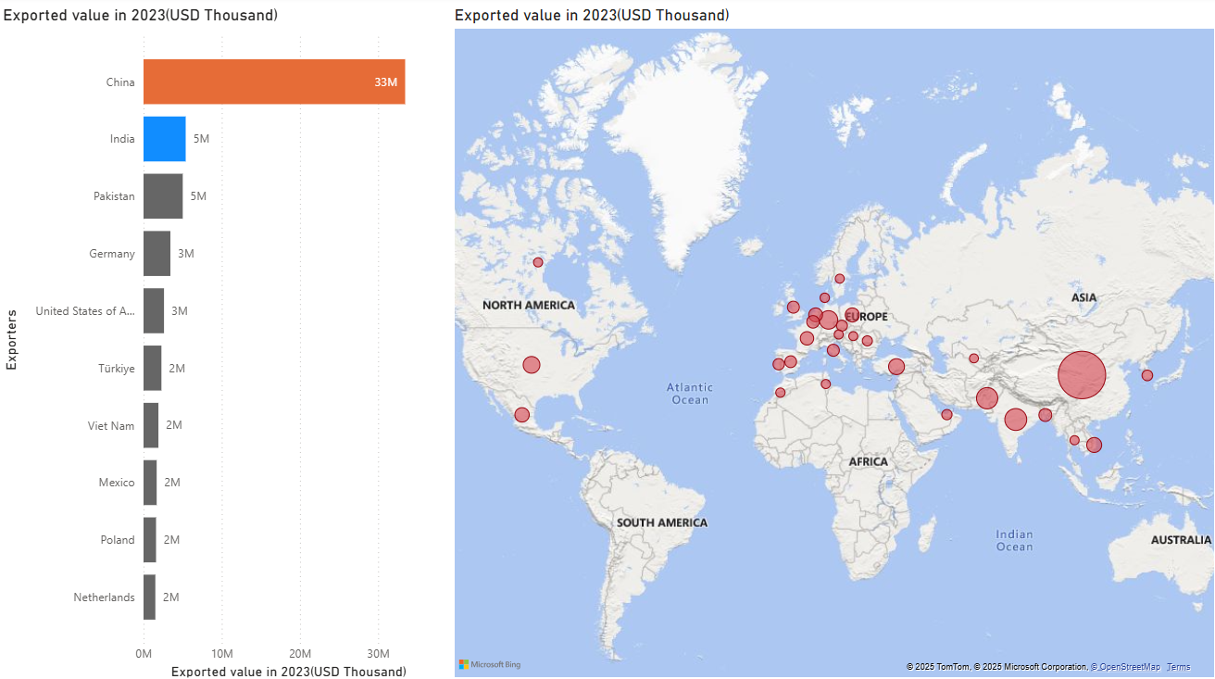
Top exporters

Slide 6

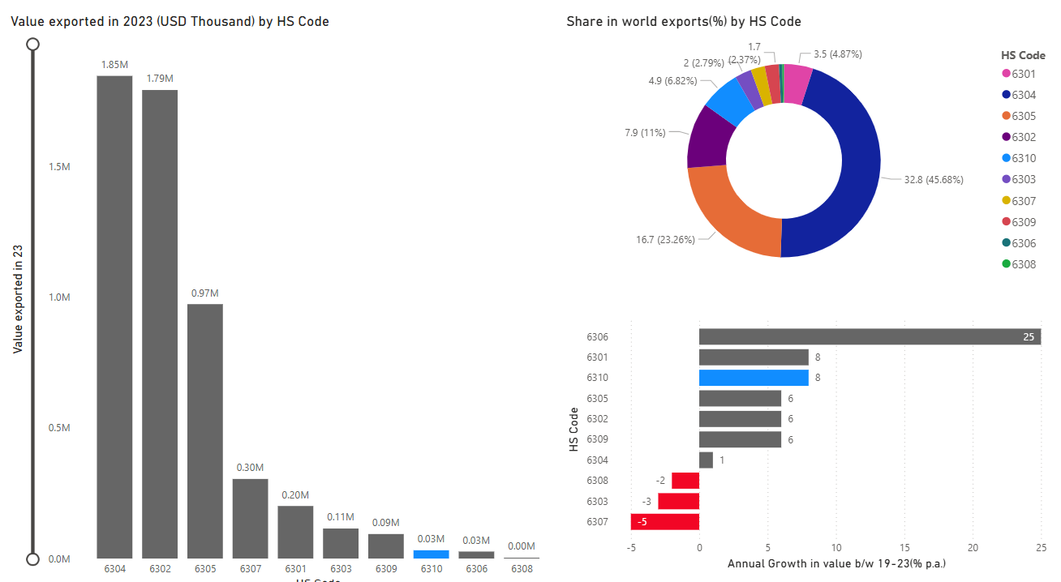
Indian Exports: 63 family

Slide 7

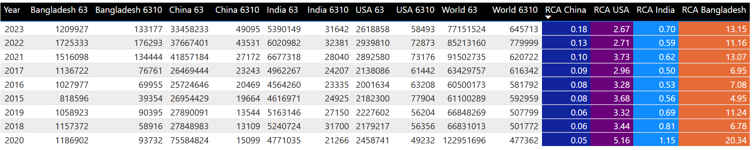
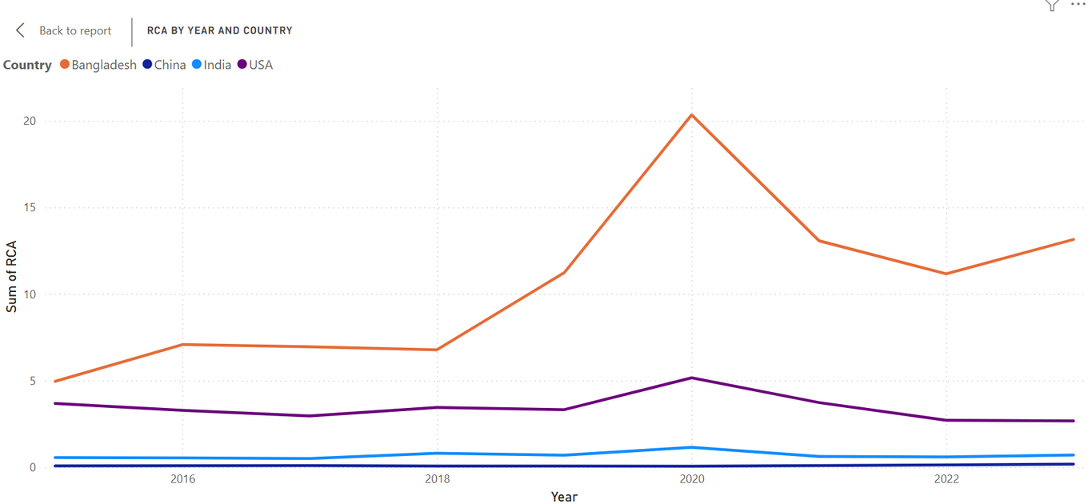
RCA

Slide 8
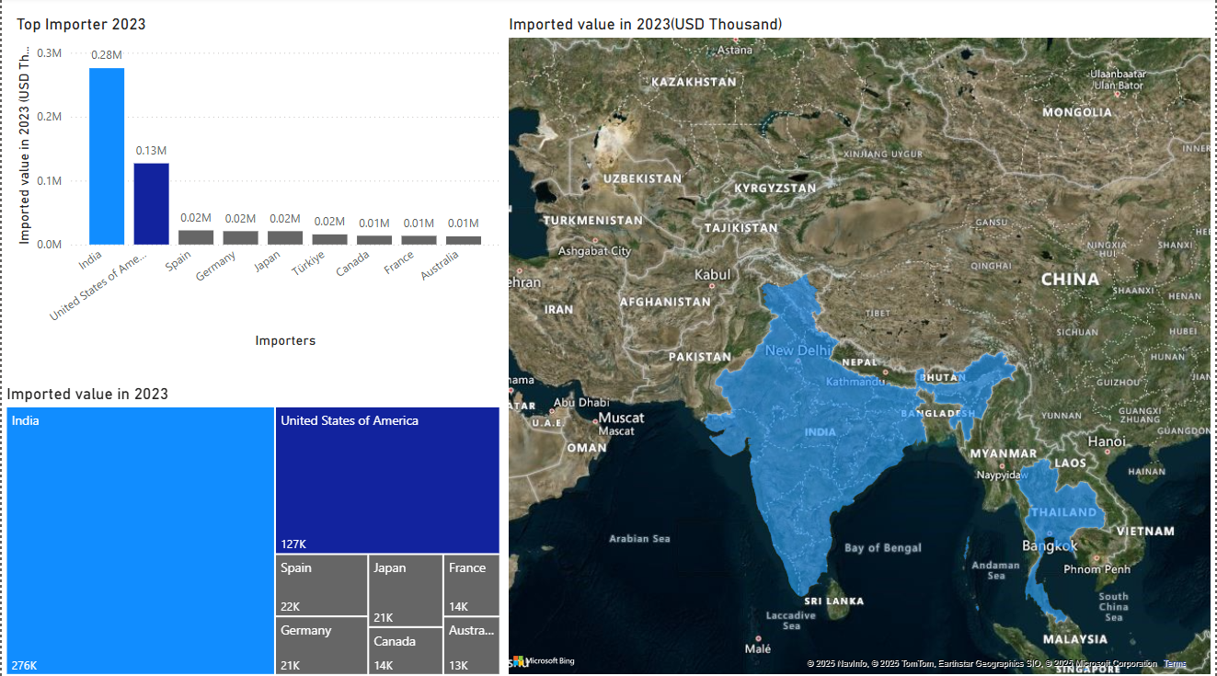
TOP IMPORTERS 6310

Slide 9
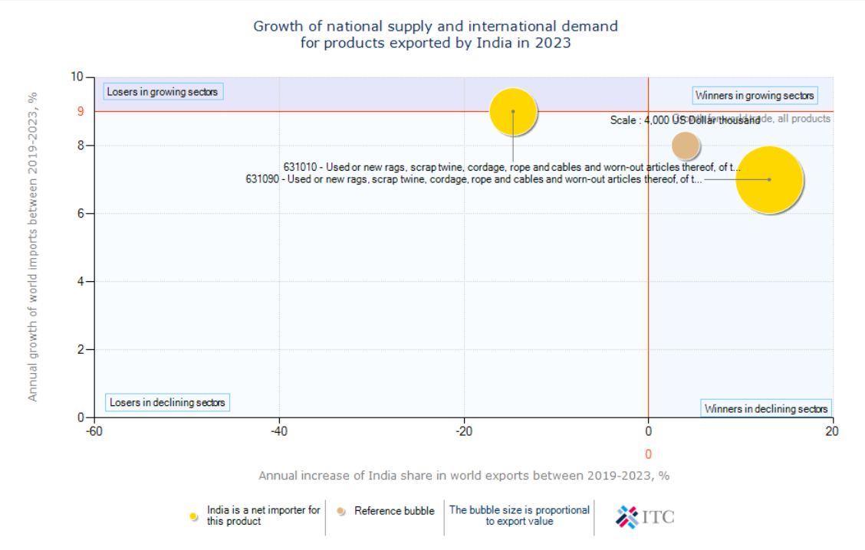
INDIA EXPORT GROWTH VS WORLD IMPORT GROWTH

Slide 10
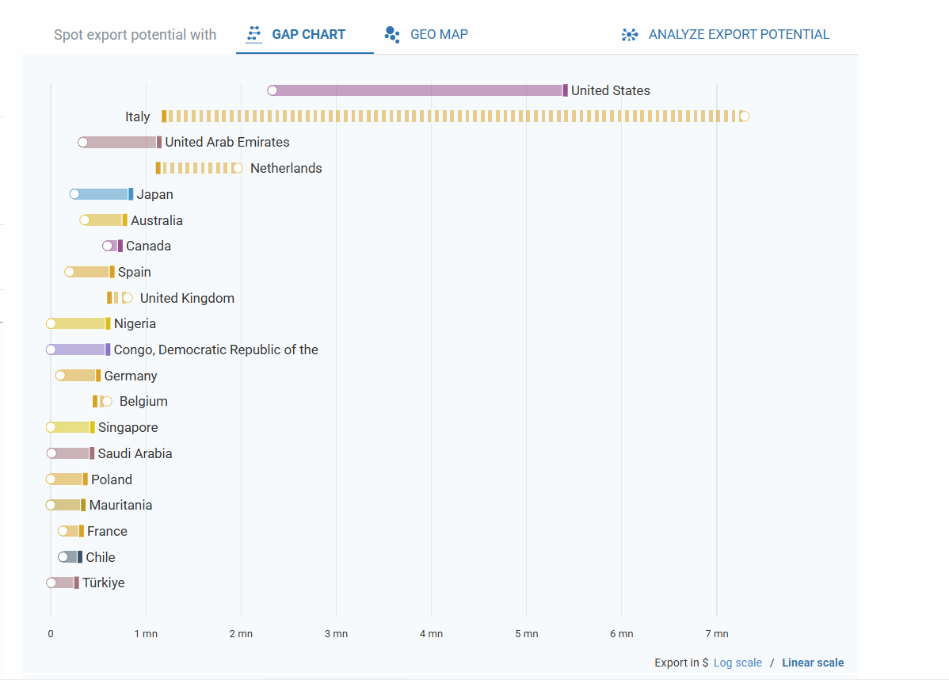
EXPORT POTENTIAL 631010

Slide 11
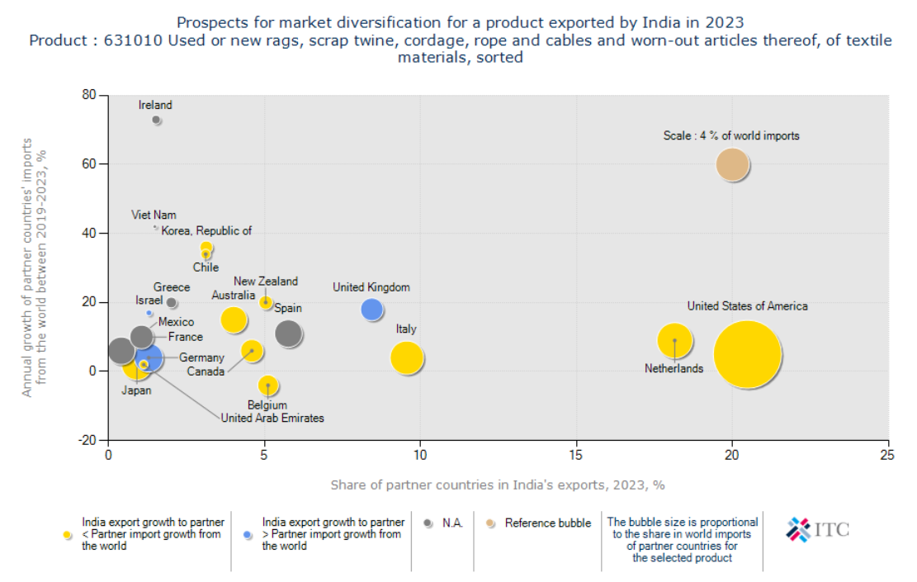
INDIA EXPORT- MARKET DIVERSIFICATION

Slide 12
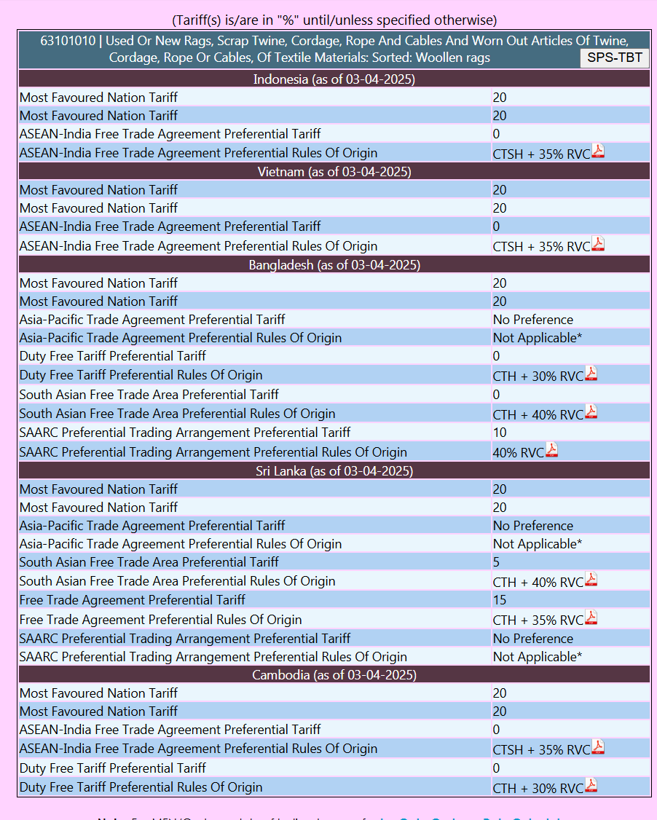
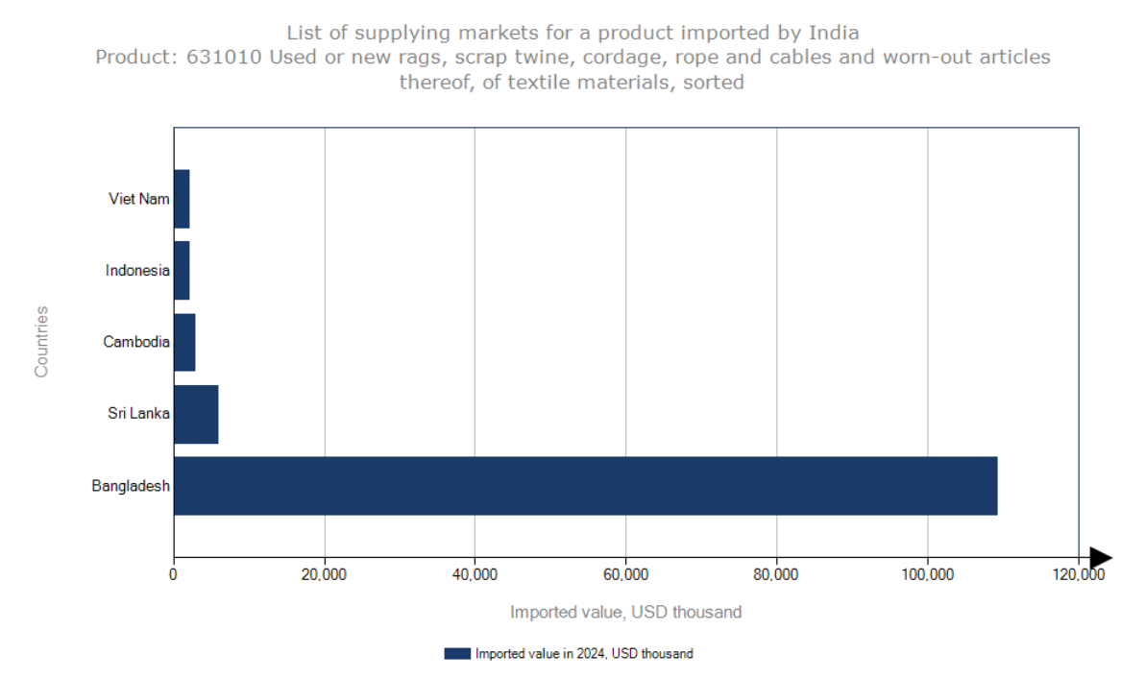
Tariffs for Import into India

Slide 13
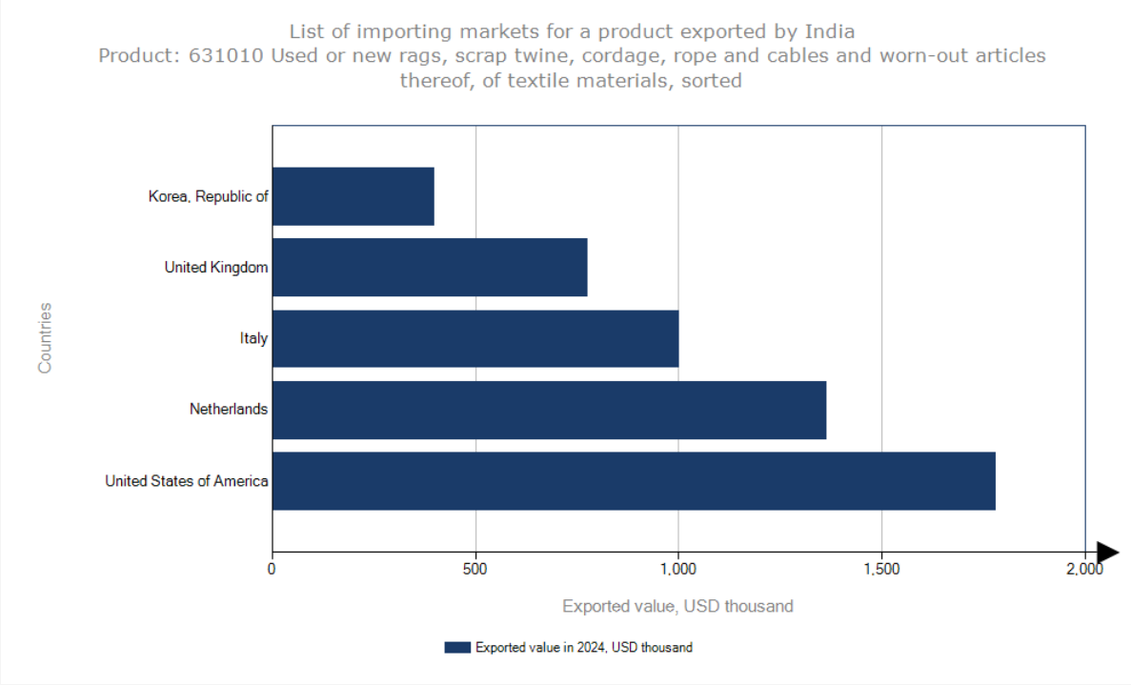
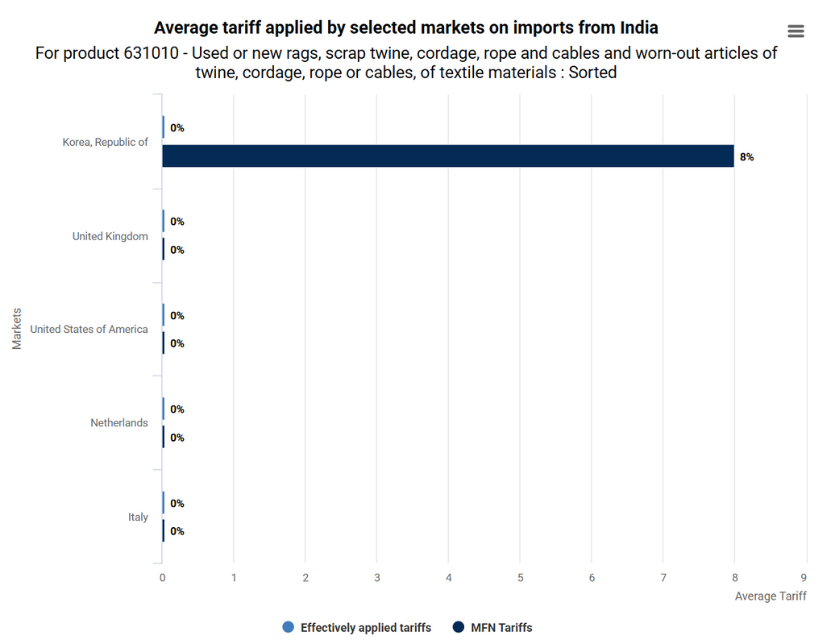
Tariffs on Exports from India

Slide 14



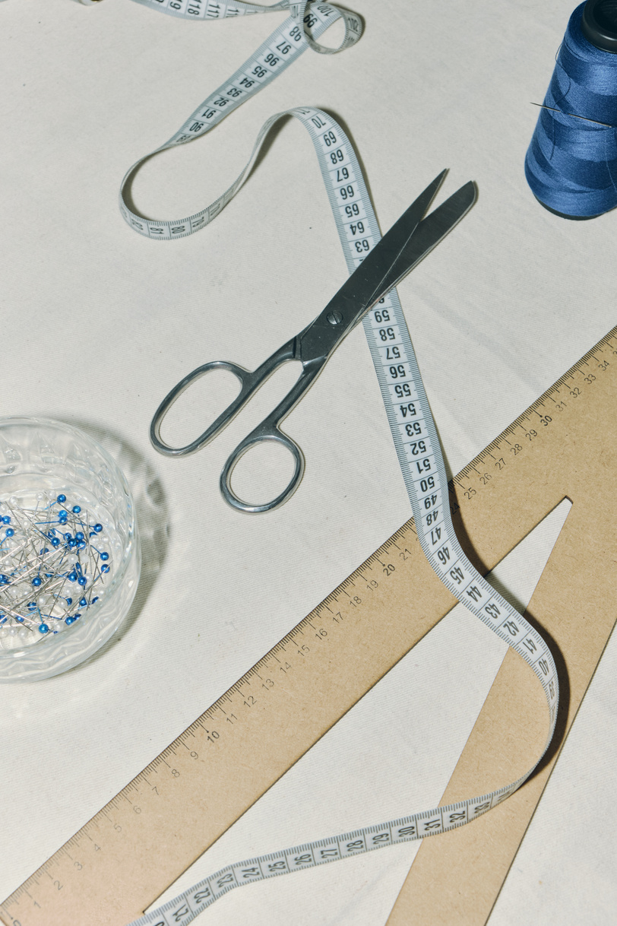
Export Promotion Councils
Wool & Woollens Export Promotion Council (WWEPC)
Cotton Textiles Export Promotion Council (TEXPROCIL)
Jute Products Development & Export Promotion Council (JPDEPC)
Carpet Export Promotion Council (CEPC)

Slide 15
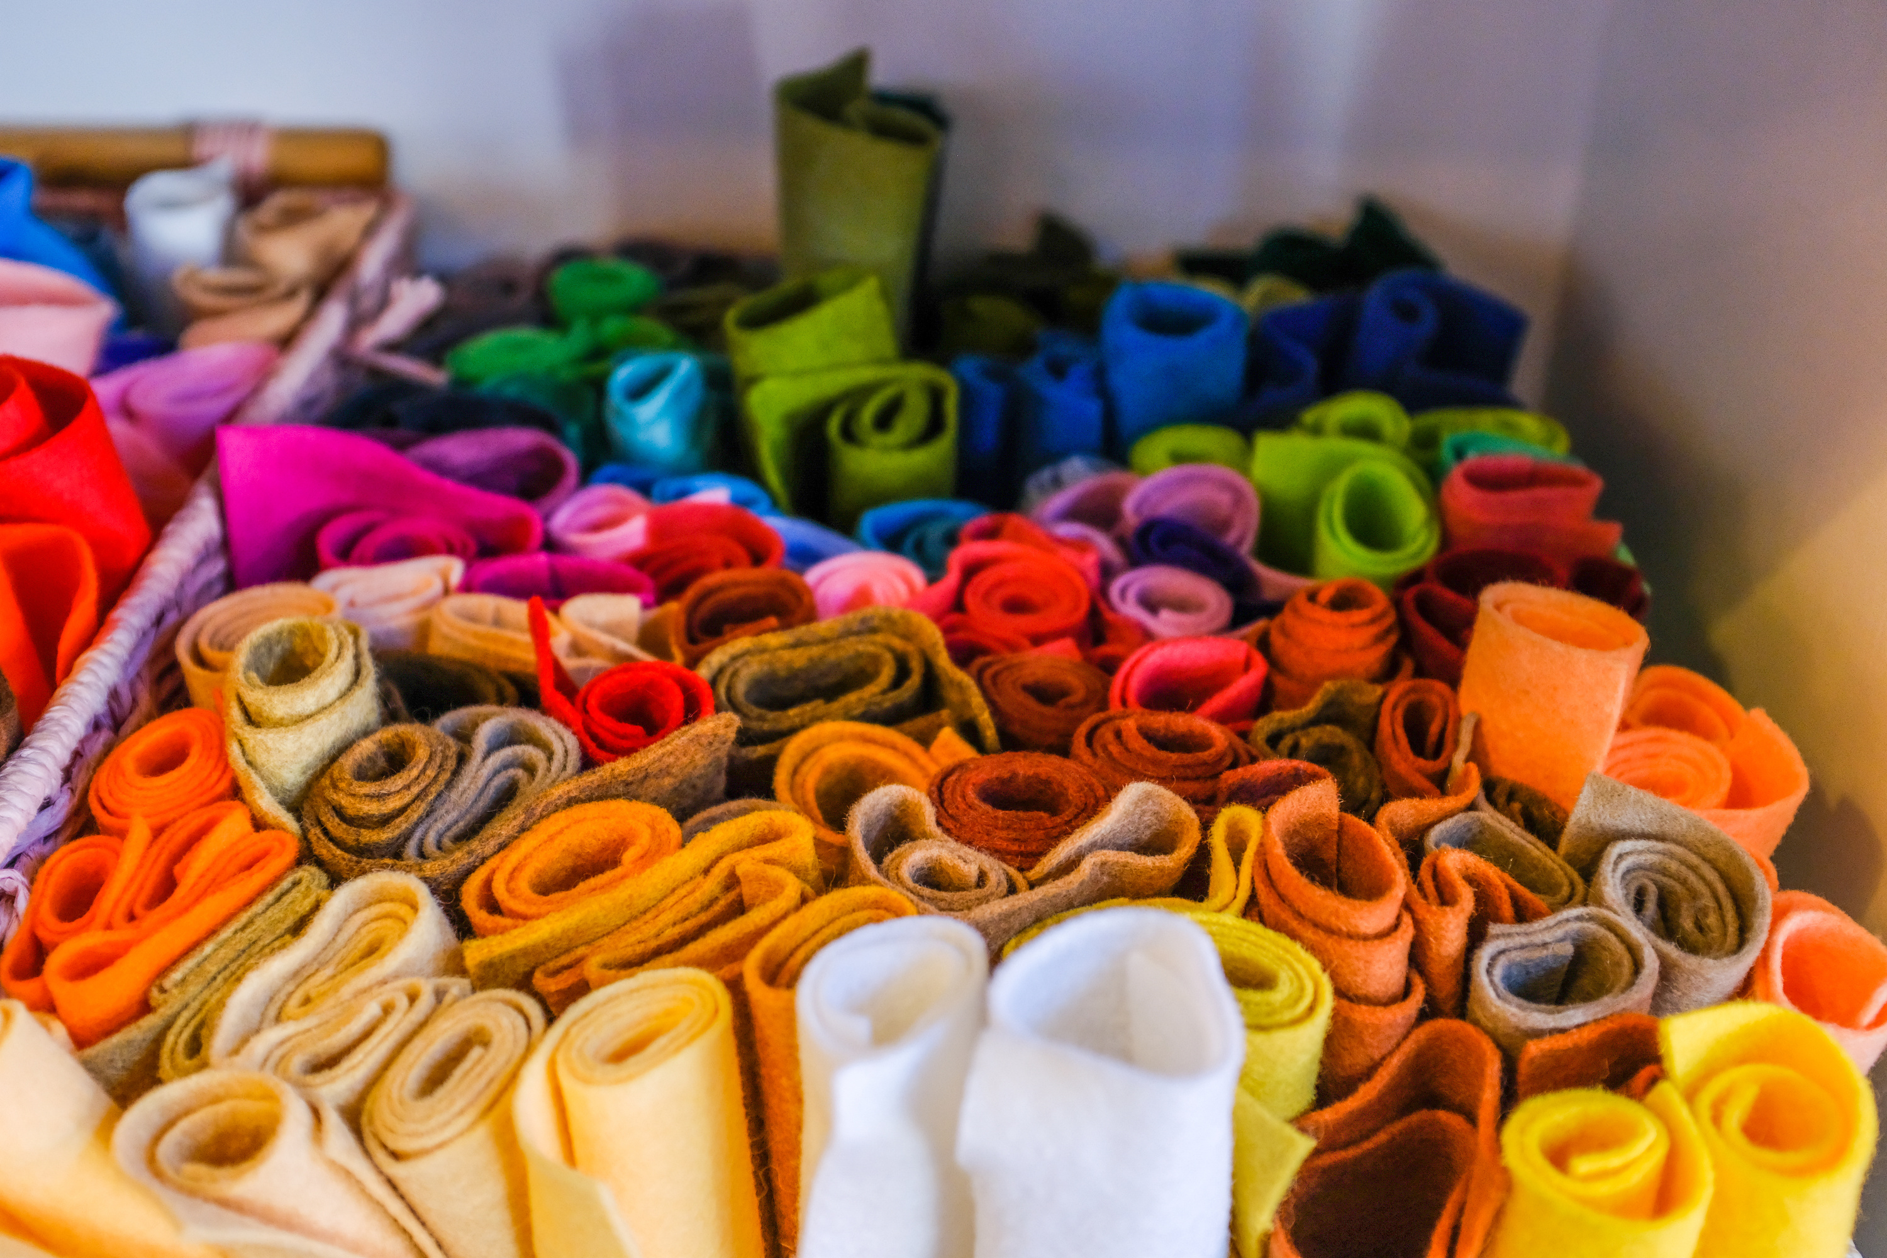
Textile Parks
Tamil Nadu
Telangana
Gujarat
Karnataka
Madhya Pradesh
Uttar Pradesh
Maharashtra

Slide 16

Branding and Value Addition

Slide 17

India’s Missed Billion-Dollar Opportunity
From Textile Waste to Global Circular Exports
Problems
Opportunity
92M tons of global textile waste generated annually
Industrial cleaning, construction, and fashion sectors seek sustainable inputs
India exports rag material without value addition, missing a $3B+ global opportunity
India: World’s 2nd largest textile producer, but underleveraged in textile waste processing
Abundant raw material, low-cost labor, existing recycling clusters (Panipat, Tirupur)
Global shift toward ESG & Circular Supply Chains = huge export opportunity

Slide 18

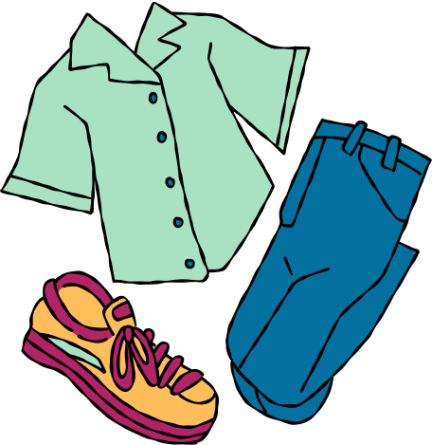
Introducing "Ragveda" – Circular Textiles
From Textile Waste to Global Circular Exports
Industrial Rags: Color-coded, sterilized, compressed rags for auto, aviation, marine
Recycled Yarn: From shredded rags → spun fiber →textiles
Upcycled Goods: Rugs, patchwork throws, homeware for D2C
Impact-as-a-Service: Export clients get traceability + carbon offset data
Blending artisan skill, tech-enabled sorting & sustainable branding

Slide 19

Our Value Chain Advantage
From Waste to Wealth — The Indian Edge
Step | India’s Edge
Raw Material Access | Surplus post-consumer and industrial textile waste from hubs like Delhi, Tirupur, Ludhiana
Sorting & Processing | Cost-effective manual labor ensures high-precision sorting (by color, fabric, condition)
Re-manufacturing | Existing infrastructure in Panipat, Surat for recycled yarn, insulation, and felt
Artisan Value Add | Access to traditional techniques: patchwork, block printing, hand embroidery
Export Focus | Aligns with EU EPR mandates & US sustainability demand; great carbon credit potential

Slide 20

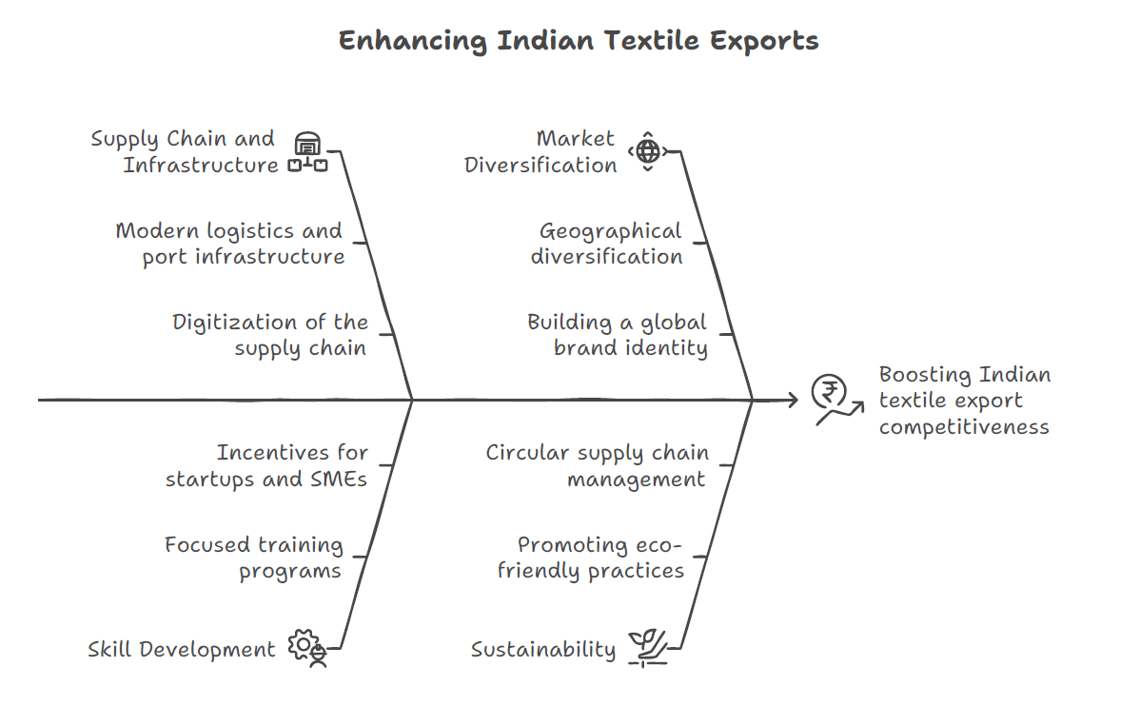

Slide 21
